Slide 1
Mental Health Reminder Update
August 2018

Slide 2
Overview
Updating existing processes to incorporate both population and evidence based approach to suicide risk screening
PHQ-2 and PC-PTSD screening tools are being updated to include Q9 from the PHQ-9.
Question 9, also referred to as Item 9 (I9), is being used for primary suicide risk screening during Depression and PTSD screening.
Notes:
The PC-PTSD instrument is also undergoing a revision-discussed on slide 4. Q9 will be labeled q3 in the depression clinical reminder. The primary screen will be highly sensitive, and consists of a single question, item 9 from the Patient Health Questionnaire-9 (PHQ-9).
References: 1. Does response on the PHQ-9 Depression Questionnaire predict subsequent suicide attempt or suicide death? Simon GE, Rutter CM, Peterson D, Oliver M, Whiteside U, Operskalski B, Ludman EJ. Psychiatr Serv. 2013 Dec 1;64(12):1195-202.
2. 2. Does Suicidal Ideation as Measured by the PHQ-9 Predict Suicide Among VA Patients? Louzon SA, Bossarte R, McCarthy JF, Katz IR. Psychiatr Serv. 2016 May 1;67(5):517-22.

Slide 3
Rationale
Historically, VA has not had a national standard for screening, assessment, or documentation of suicide risk
The Veterans Health Administration (VHA) Office of Mental Health and Suicide Prevention (OMHSP) has launched an effort to develop and implement a national, standardized process for suicide risk screening and assessment, using high-quality, evidence-based tools and practices
This process is to be implemented FY19
This process is part of FY19 EPRP

Slide 4
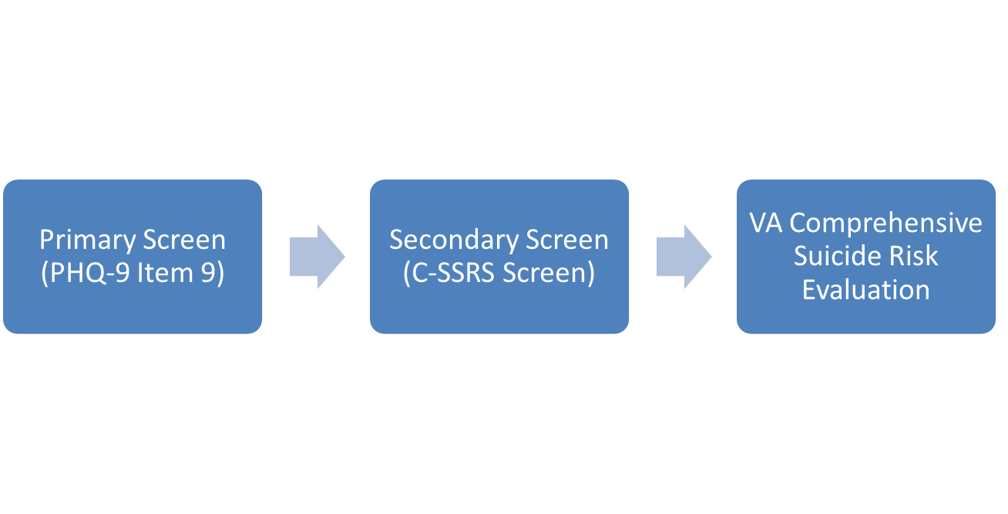
Three-Stage Process
Dependency on MHA Patch 134
Item #9 will be added to existing screening questionnaires for Depression (PHQ-2) and PTSD (PC-PTSD-5)
Identifies those who may be at risk
Standardized questionnaire with specific items about suicidal thoughts, plans and behavior
Improves specificity of screening
Documentation using national clinical reminder dialog template to capture clinical impressions about acute and chronic suicide risk and associated disposition

Slide 5
Informatics Tools for Implementation
MHA Patch YS*5.01*134
Updates to national clinical reminders
  Reminder Update_2_0_53
  VA-DEPRESSION SCREENING
  VA-PTSD SCREENING
  VA-FOLLOW-UP POS PTSD/DEP COMBINATION
Comprehensive Suicide Risk Assessment clinical reminder dialog template
  Reminder Update_2_0_43

Slide 6
MHA Patch YS*5.01*134
Adds 6 new clinical instruments to Mental Health Assistant software in support of suicide risk assessment
  PHQ-2+i9 (required for combined depression, suicide ideation screening)
  PC-PTSD-5+i9 (required for combined PTSD, suicide ideation screening)
  PC-PTSD-5
  C-SSRS—Columbia Suicide Severity Scale (required for second level suicide risk screen)
  PSS—Patient Safety Screener
  WHODAS-12—WHO Disability Assessment Schedule

Slide 7
Clinical Reminder Updates
Updates to national clinical reminders - Reminder Update_2_0_53
  VA-DEPRESSION SCREENING
  VA-PTSD SCREENING
  VA-FOLLOW-UP POS PTSD/DEP COMBINATION
Integrates new suicide risk identification requirements
Uses instruments introduced in patch YS*5.01*134
Test sites: Orlando, Milwaukee

Slide 8
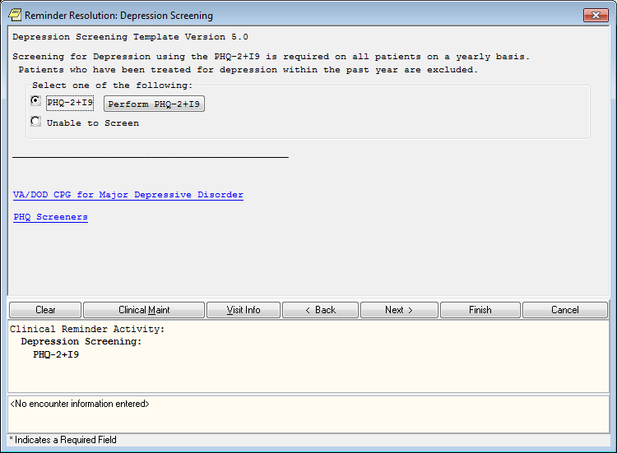
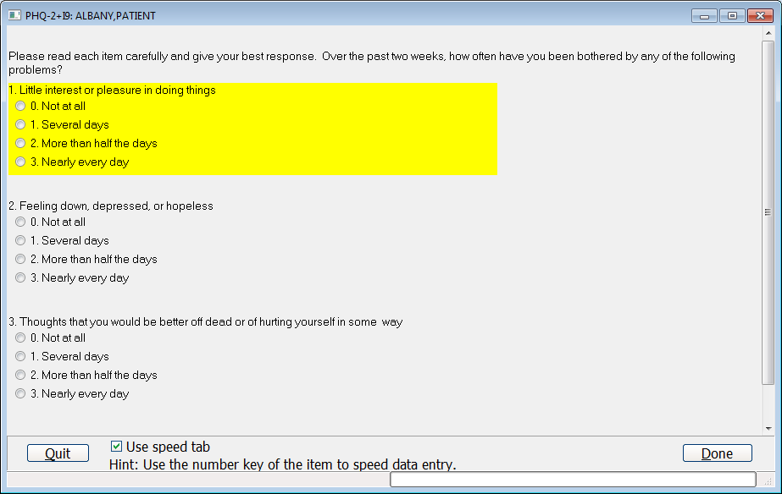
Depression Screen
Updated to PHQ-2+I9 (Q3 below)

Slide 9
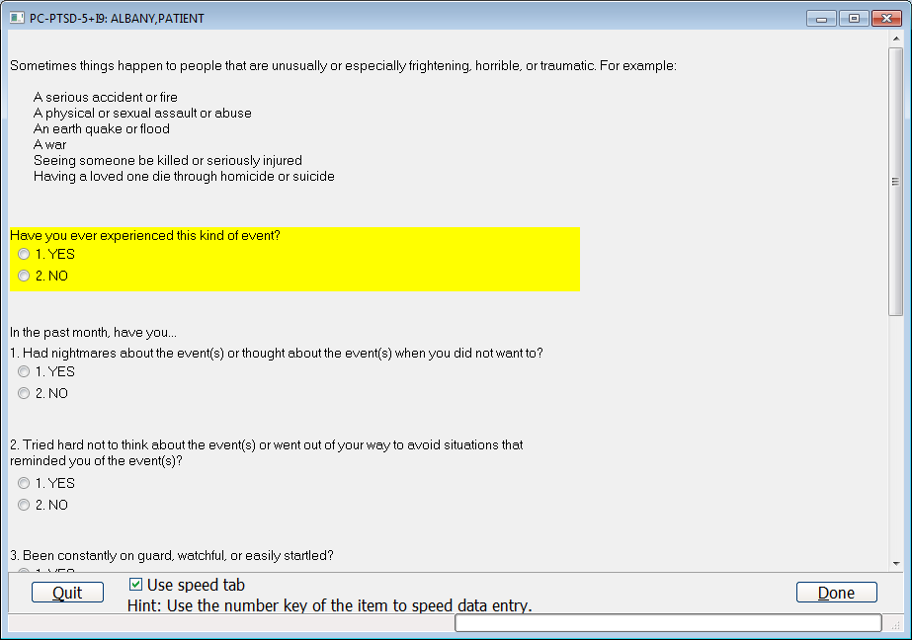
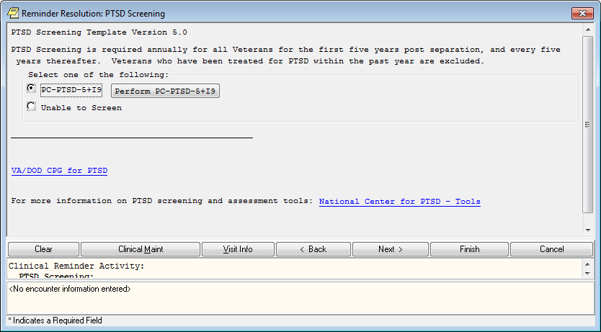
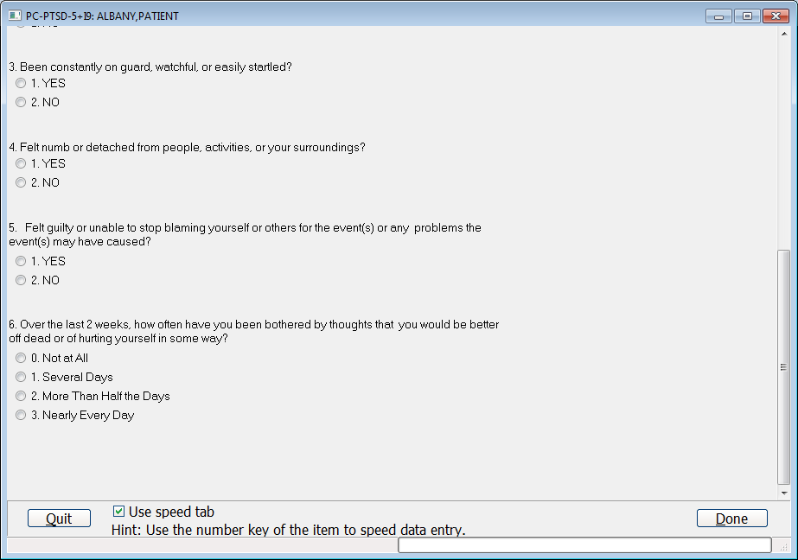
PTSD Screen
Updated to PC-PTSD-5+I9 (Q6)
Notes:
The PC-PTSD screen has been updated to use the PC-PTSD-5 plus Q9/I9 for primary suicide risk screening. Refer to the PTSD CPG for additional information. Please note, the time references to the questions. There is now an overall question and if positive, will move on to question 1.

Slide 10
“Pop Up Messages”
There are two possible pop up messages for a positive screen – one for the screen portion and one for the I9 portion
  This applies to both Depression and PTSD
Any part being positive (the screen, the I9 or both) will trigger the follow up reminder
  This applies to both Depression and PTSD

Slide 11
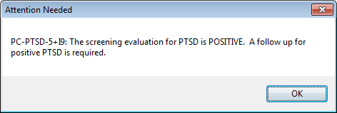
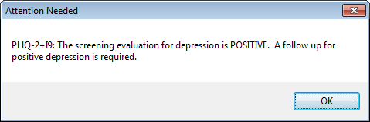
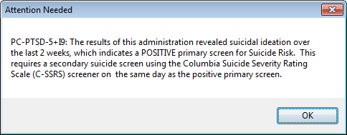
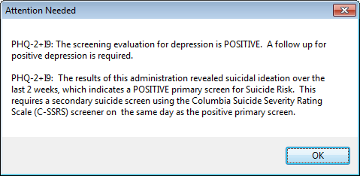
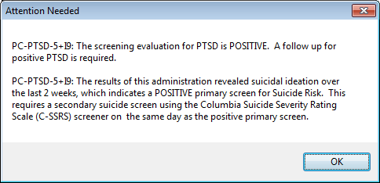
“Pop Up Messages”
If only PTSD is positive – this pop up:
If only Depression is positive – this pop up:
If only I9 is positive – this pop-up:
If Both Depression and I-9 are positive – this pop up:
If both PTSD and I9 positive – this pop up:

Slide 12
FOLLOW UP POSITIVE PTSD/DEPRESSION/SI
The Print (name provider sees) name was updated to include SI
There are no longer the old “pocket card” questions
If disorder (Depression or PTSD) was positive→ required to complete dispositions only
If Q9 was positive → required to perform secondary suicide risk screening using the Columbia C-SSRS Screener (labeled C-SSRS in MHA) same day (signed note) and required to complete dispositions
Notes:
The secondary suicide risk screening, aimed at improving specificity, will consist of the Columbia-Suicide Severity Rating Scale (C-SSRS) Screener. Secondary suicide risk screening is required if the primary suicide risk screen is positive when conducting the annual depression and/or PTSD screen.

Slide 13
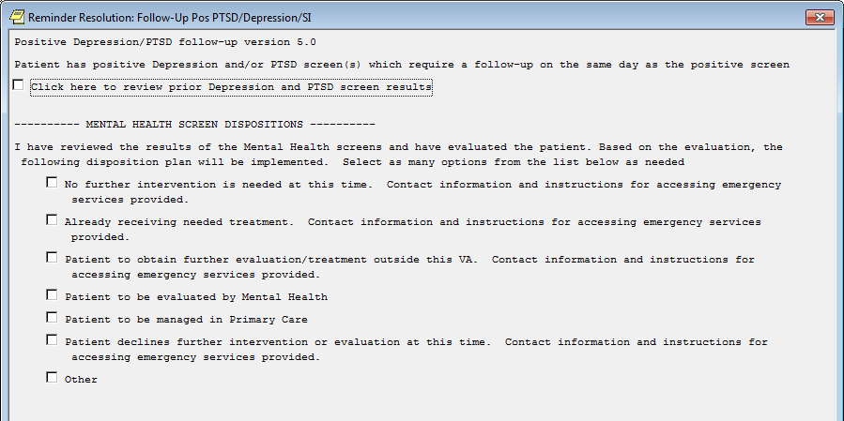
FOLLOW UP POSITIVE PTSD/DEPRESSION/SI
Follow-up if only Depression or PTSD Screen is positive and NOT Q9 (negative primary suicide risk)

Slide 14
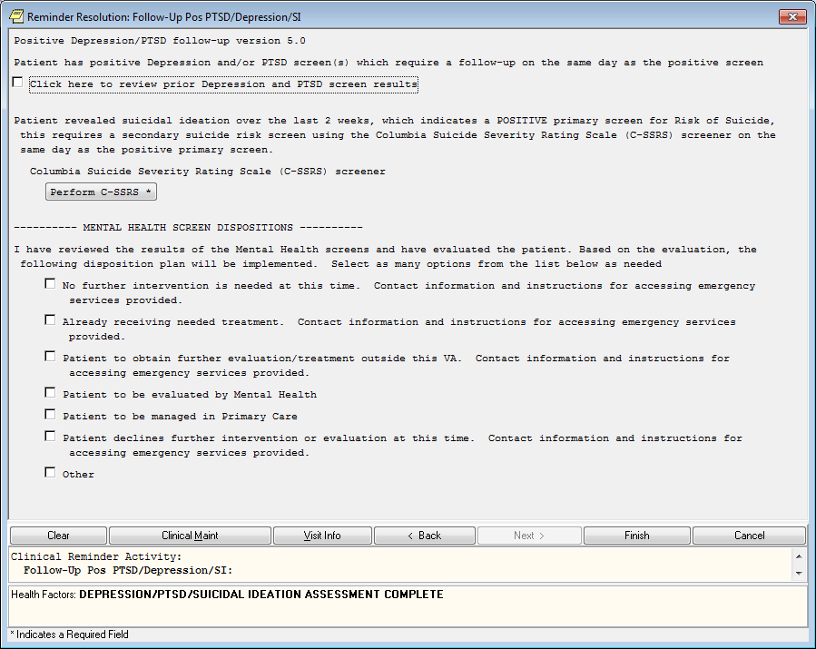
FOLLOW UP POSITIVE PTSD/DEPRESSION/SI
Follow up if Q9 is positive includes Columbia C-SSRS Screener (Depression or PTSD portion may or may not be positive) - due same day

Slide 15
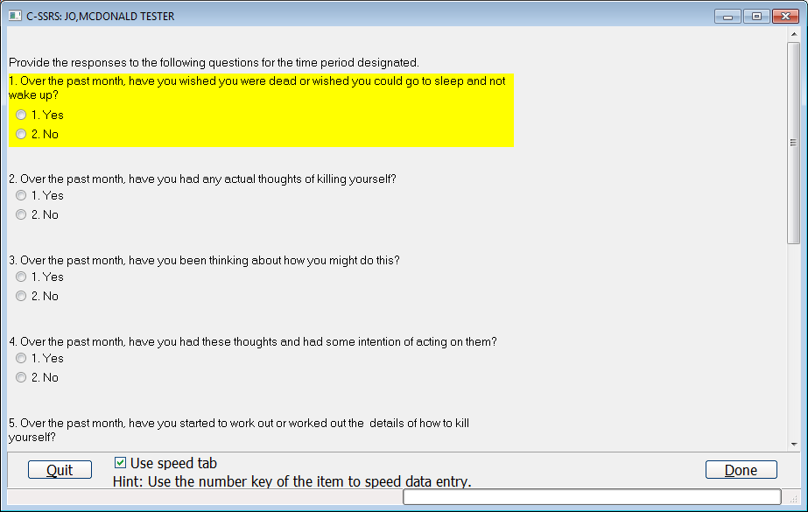
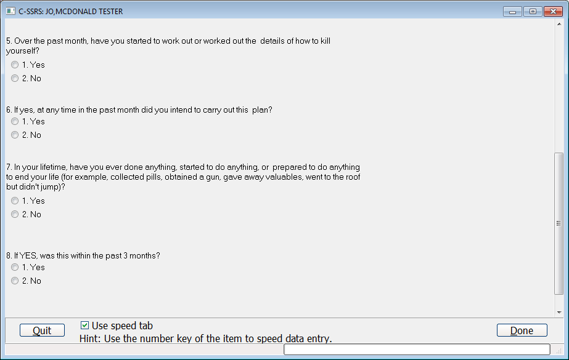
Columbia C-SSRS Screener

Slide 16
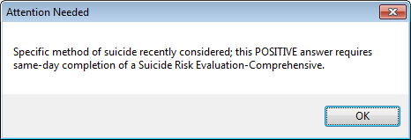
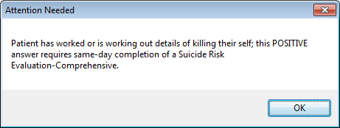
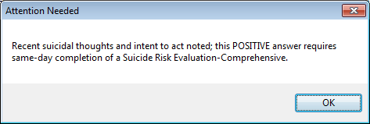
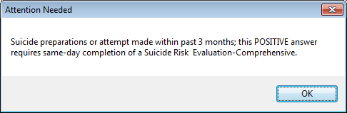
“Pop Up Messages”
A YES to any one of questions 3,4,5 or 8 will generate a pop up message to the user
Q3:
Q5:
Q4:
Q8:

Slide 17
Positive responses to Columbia Secondary Suicide Screener
An answer of Yes to any one of the following questions 3,4,5 or 8 requires a same day Comprehensive Suicide Risk Assessment (CSRA) follow up using the note title SUICIDE RISK EVALUATION-COMPREHENSIVE which should be connected to the reminder dialog VA-OSP SUICIDE RISK ASSESSMENT
There is not a reminder definition associated with the comprehensive suicide risk assessment.
Notes:
The reminder dialog VA-OSP SUICIDE RISK ASSESSMENT will be released as clinical reminder update_2_0_43

Slide 18
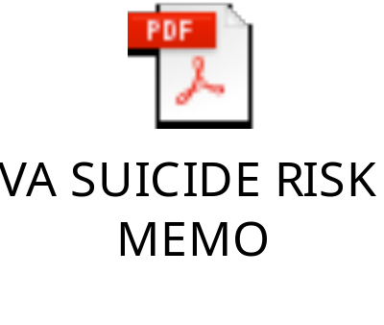


Resources
VA SUICIDE RISK SCREENING AND ASSESSMENT REQUIREMENTS MEMO AND ATTACHMENTS A AND B

Slide 19
Resources
OMHSP Suicide Risk Identification: Suicide Risk Identification SharePoint site
ClinicalReminderUpdates:http://vista.med.va.gov/reminders/Reminders.html
PerformanceMeasures:http://vaww.car.rtp.med.va.gov/programs/pm/pmETechMan.aspx
MHA: https://www.va.gov/vdl/application.asp?appid=78

